Slide 1
Topic: Right-angled Triangles
EQ – How do we use Pythagoras to find the length of the shorter side?

Slide 2
Learning Intentions
Students will be able to
Recall the important definitions used in algebra

Slide 3
A plane flies 120km due north, and then heads due east for 80km. How far is the plane from it’s starting point?
How do we calculate the final distance?
80km
120km

Slide 4
24
7
30
Right-angled triangles
Date:
EQ – How do we use Pythagoras to find the length of the shorter sides?
We can also use Pythagoras’ theorem to find the length of a shorter
a² = c² – b²
Square the longer side
Subtract the square of the other known side
Square root your answer to get the unknown shorter side
How do you find the length of the shorter side?

Slide 5
Practice
Example:
Find the length of side “a”.
a² = c² - b²
a² = 13² - 12²
a² = 169 - 144
a² = 25
a = √25
a = 5 cm
13cm
12cm
a

Slide 6
Practice
b² = a² - c²
b² = 14² - 6²
b² = 196 - 36
b² = 160
b = √160
b = 12.65 cm
6cm
b
14cm

Slide 7


Slide 8
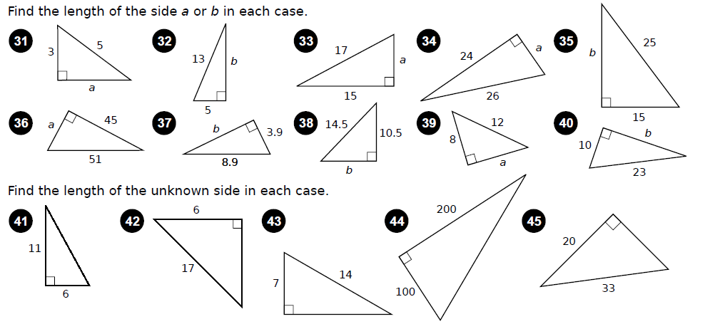
Task

